Slide 1
KScoC

Slide 2
Understanding the “Sinner’s Prayer” Part 1
Cheap Grace

Slide 3
Pilgrim's Progress
John Bunyan (1678)
God be merciful to me a sinner, and make me to know and believe in Jesus Christ; for I see, that if His righteousness had not been, or I have not faith in that righteousness, I am utterly cast away.

Slide 4
Pilgrim's Progress
John Bunyan (1678)
Lord, I have heard that thou art a merciful God, and hast ordained that thy Son Jesus Christ should be the Savior of the world; and moreover, that thou art willing to bestow Him upon such a poor sinner as I am—and I am a sinner indeed. Lord, take therefore this opportunity, and magnify thy grace in the salvation of my soul, through thy Son Jesus Christ. Amen.

Slide 5
Modern Version
Billy Graham
Dear Lord Jesus, I know that I am a sinner, and I ask for Your forgiveness. I believe You died for my sins and rose from the dead. I turn from my sins and invite You to come into my heart and life. I want to trust and follow You as my Lord and Savior. In Your Name. Amen

Slide 6
Related Doctrines
Once prayed, always saved. Sins after "the prayer" are automatically forgiven.
The saved do not sin (1). If one sins after the prayer, one was never saved in the first place.
The saved do not sin (2). After saying "the sinner’s prayer," what the Bible calls sin is no longer sin for you.

Slide 7
Related Doctrines
Having to do anything - confession, baptism, etc. to be saved - means that you believe in salvation by works. Ergo: obedience = works
Even the prayer is not really necessary, since one is saved by faith alone. Requiring the prayer makes it a "work" as well.

Slide 8
Growing Objections
This prayer is found nowhere in the Bible
Relying on such a prayer creates a false sense of security
No real commitment is required by the convert
Many scriptures used to justify the "sinners prayer" are misapplied or taken out of context

Slide 9
David Gushee Christianity Today
“Shallow commitment”
Anyone can, and most Americans do, "believe" in Jesus rather than some alternative savior. Anyone can, and many Americans sometimes do, say a prayer asking Jesus to save them. But not many embark on a life fully devoted to the love of God, the love of neighbor, the moral practice of God's will, and radical, costly discipleship.
Notes:
Gushee points to widespread hypocrisy among many who say they are believers and concludes the above.
He received his PhD in Christian ethics from Union Theological Seminary in 1993. He is reported to be a Christian Ethicist.

Slide 10
David Platt
"I'm convinced that many people in our churches are simply missing the life of Christ, and a lot of it has to do with what we've sold them as the gospel, i.e. pray this prayer, “accept Jesus into your heart, invite Christ into your life.”
Should it not concern us that there is no such superstitious prayer in the New Testament? Should it not concern us that the Bible never uses the phrase, 'accept Jesus into your heart' or 'invite Christ into your life'? It's not the gospel we see being preached, it's modern evangelism built on sinking sand. And it runs the risk of disillusioning millions of souls.
Notes:
a Southern Baptist "pastor" from Birmingham AL

Slide 11
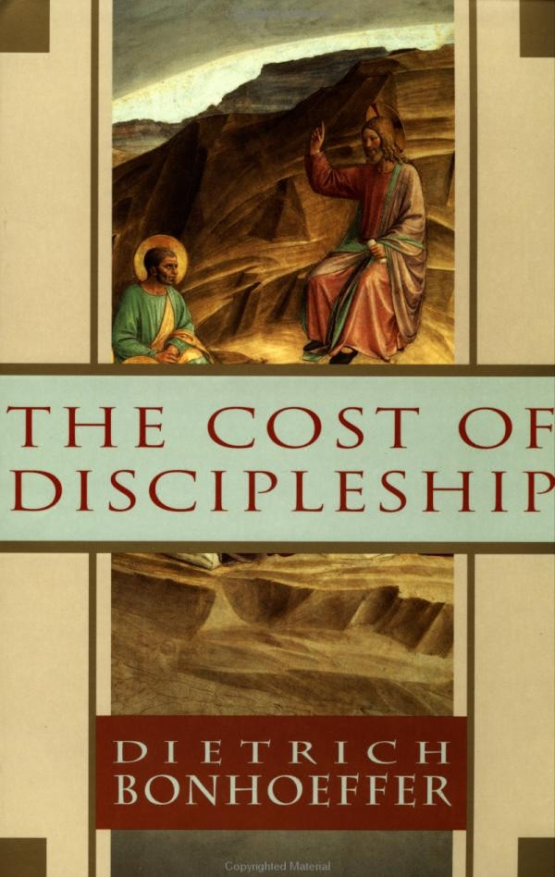
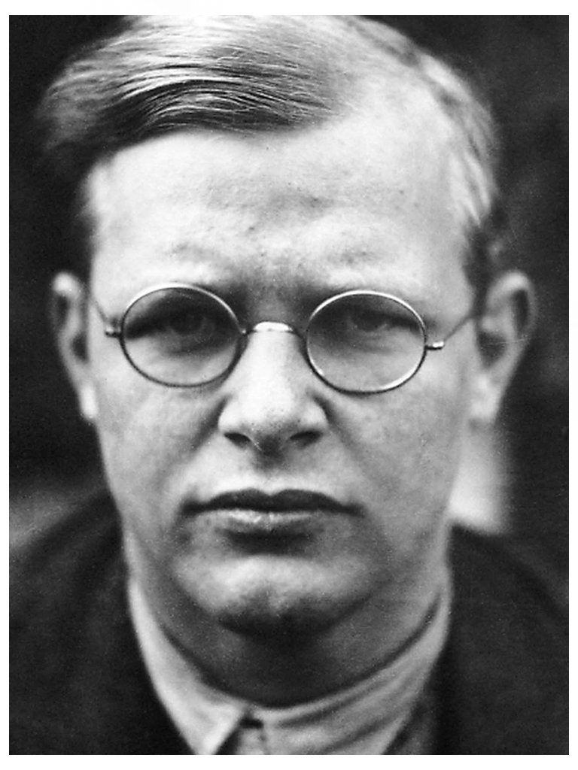
Notes:
Dietrich Bonhoeffer (1906-1945) speaks of "Cheap grace" - nothing but a prayer is needed from the "believer" because anything more than that is a "work" and we are not saved by works. Bonhoffer was hung by the Nazi's because of his faith in his God.

Slide 13
What Did Jesus Say?
God loved the world so intensely… John 3:16
You shall love the LORD your God with all your heart, with all your soul, with all your mind, and with all your strength ... Mark 12:30
Deepest Love
Christians are blessed to share this love!

Slide 14
Deepest Devotion
2 Corinthians 5:14-15 For the love of Christ compels us, because we judge thus: that if One died for all, then all died; and He died for all, that those who live should live no longer for themselves, but for Him who died for them and rose again.
Galatians 2:20 I have been crucified with Christ; it is no longer I who live, but Christ lives in me; and the life which I now live in the flesh I live by faith in the Son of God, who loved me and gave Himself for me.

Slide 15
Willing Sacrifice
2 Corinthians 12:15 And I will very gladly spend and be spent for your souls …
Philippians 3:7-8 But what things were gain to me, these I have counted loss for Christ.
Yet indeed I also count all things loss for the excellence of the knowledge of Christ Jesus my Lord, for whom I have suffered the loss of all things, and count them as rubbish, that I may gain Christ

Slide 16
Lifelong Service
Mark 10:43b-45 … whoever desires to become great among you shall be your servant. And whoever of you desires to be first shall be slave of all.
For even the Son of Man did not come to be served, but to serve, and to give His life a ransom for many."

Slide 17
Good Works
Titus 3:8, 14 This is a faithful saying, and these things I want you to affirm constantly, that those who have believed in God should be careful to maintain good works. These things are good and profitable to men. … And let our people also learn to maintain good works, to meet urgent needs, that they may not be unfruitful.
Notes:
Also - Ephesians 2:10 For we are His workmanship, created in Christ Jesus for good works, which God prepared beforehand that we should walk in them.

Slide 18
Commitment & Courage
Matthew 10:37-39 He who loves father or mother more than Me is not worthy of Me. And he who loves son or daughter more than Me is not worthy of Me. And he who does not take his cross and follow after Me is not worthy of Me.
He who finds his life will lose it, and he who loses his life for My sake will find it.
Philippians 1:21 “To live is Christ and to die is gain”
Notes:
“To live is Christ and to die is gain” Paul in Philippians 1:21

Slide 19
Lifelong Obedience
John 14:15 If you love Me, keep My commandments.
Matthew 7:21 Not everyone who says to Me, 'Lord, Lord,' shall enter the kingdom of heaven, but he who does the will of My Father in heaven.

Slide 20
Many sinners’ prayers in the Bible
"God be merciful to me a sinner" - Luke 18:9-14
Daniel's prayer of confession and mercy on behalf of all Israel - Daniel 9
Ezra's confession of Israel's disobedience and guilt - Ezra 9
Paul's appeal to Jesus - “Lord, what do you want me to do?" Acts 9:6
Notes:
Anyone praying is a sinner praying a prayer, of course. But the idea is a sinner praying for forgiveness and salvation.

Slide 21
KScoC

